Slide 1
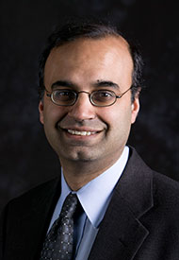
Deepto Chakrabarty
Notes:
#Name Deepto Chakrabarty # Textbook Knight, Physics for Scientists and Engineers: A Strategic Approach with Modern Physics, 3rd Edition, Chapter 24 Knight, Physics for Scientists and Engineers: A Strategic Approach with Modern Physics, 3rd Edition, Chapter 13 # Description "In 1996, Prof. Chakrabarty was awarded the Ph.D. in Physics from the California Institute of Technology, following two years at the Lawrence Berkeley National Laboratory (1988-90) as a staff Physicist working on the Berkeley Automated Supernova Search. Prior to that, he completed his S.B. in Physics at MIT, in 1988. Professor Chakrabarty returned to MIT in 1996 for a two-year appointment as a NASA Compton GRO Postdoctoral Fellow, followed by a year spent as a Visiting Fellow at Balliol College, Oxford University (1998). In 1999, he accepted an Assistant Professorship within the Department of Physics at MIT. He was promoted to Associate Professor, with tenure, in July 2004. Professor Chakrabarty's most recent awards include an Alfred P. Sloan Research Fellowship (2001-03)." # Sources http://web.mit.edu/physics/people/faculty/chakrabarty_deepto.html # Photo http://web.mit.edu/physics/images/faculty/chakrabarty_deepto.jpg

